Slide 1
Applications of cs & it in administrative management

Slide 2
MEET THE Star dusts
Ansar Ausama
A. A. Yousif
42110161
Reem Ayman
Eissa
42110099
Esraa Ibrahim
Abd El-Aziz
42110443
Rawan Elsayed
Hashim Ibrahim
42110142
Team Leader
Salma
Abd-Rabbo Abdel Bari
42110089
Esraa Ahmed
Saeed Abdul Samad
42110123

Slide 3
Main points
1) What is administrative management?
2) The beginning of Administrative Management
3) Importance of CS in Administrative Management
4) What is the impact of computer science?
5) Performance Management for Administrators
6) Improving management productivity

Slide 4
1) What is administrative management?
Definition
An example of a good administrative manager

Slide 5
1) What is administrative management?
The difference between Administration and management:
Administration:
Management:
“Administration means the overall determination of policies, setting of major objectives, the identification of general purposes and laying down of broad programs and projects”. -Theo Haimann
Management means the way a manager manages the company or an organization by distributing work to employees.
Management means the way a manager manages the company or an organization by distributing work to employees.

Slide 6
2) The beginning
Why it started?

Slide 7
2) The beginning
The Three Theories
Points of view
Agreements
The big picture
The right way
Managing
Standardized approach to work
Centralization of Authority
Separation of personal life and work
Wanting to get the best employees
At least in theory, they all thought about paying fair salaries

Slide 8



3) Importance of CS in Administrative Management
Organizing and analyzing data and files

Slide 9
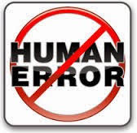
3) Importance of CS in Administrative Management
Reducing human error

Slide 10

3) Importance of CS in Administrative Management
Managing customer and partner relationship

Slide 11
4) What is the impact of computer science?
-Highlights and underlines of computer science:
Computer science is keeping up with our age
The computer needs to be developed

Slide 12
4) What is the impact of computer science?
Administrative management is the mechanism for achievement
Some examples of the impact of CS on administrative management
Customer_ID | Customer_Name | Customer_Email | Customer_Address
1 | John | john@gmail.com | 123 Park Place
2 | Jane | jane@gmail.com | #A State Avenue
3 | Tom | tom@gmail.com | 211 Apartment #1
4 | Will | will@gmail.com | 1818 Drive Street
5 | Mary | mary@gmail.com | 8181 Street Drive

Slide 13

4) What is the impact of computer science?
Hand in hand

Slide 14

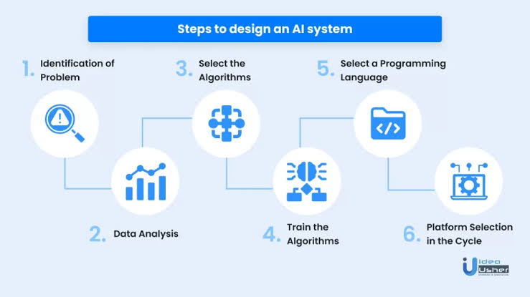
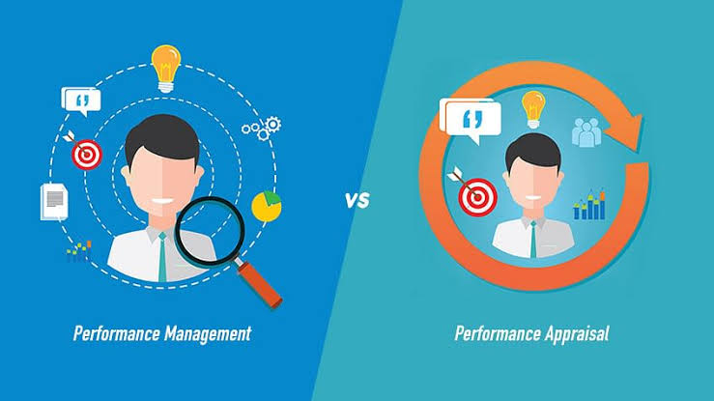

5) Performance Management for Administrators
Purpose administration policy’s core components:
Position Description
Feedback on performance & development
Manage performance issues &interests

Slide 15
5) Performance Management for Administrators
Benefits of performance management:
Discovering employees’ skills
Makes employees face new challenges
Provides great job opportunities
Provides justice
Applies performance standards

Slide 16


6) Improving management productivity
What is productivity management?
Employee productivity​
Manager productivity​

Slide 17



6) Improving management productivity
4 important ways to improve productivity :
Setting realistic goals ​
Improving workplace conditions ​
Develop your business team ​
Giving priority to employee health​

Slide 18


6) Improving management productivity
5 simple ways to use technology to increase productivity :
Benefits of Increased Productivity​
Data Sharing
Collaboration Tools​
Allow Work From Home​
CRM Software​
Online Customer Service​

Slide 19
THANK YOU

